Slide 1
Bootstrap – Step 6

Slide 2
Bootstrap
Bootstrap is a open source css web responsive web framework.
Bootstrap provided lot of pre defined classes base upon the dom elements.
Rather than writing all css rules from scratch. We can take the help of bootstrap to add the bootstrap features.
Bootstrap is not a replacement of CSS.
The provided standard Pre defined classes which we can use it. If you need to custom CSS then we can use css also.

Slide 3
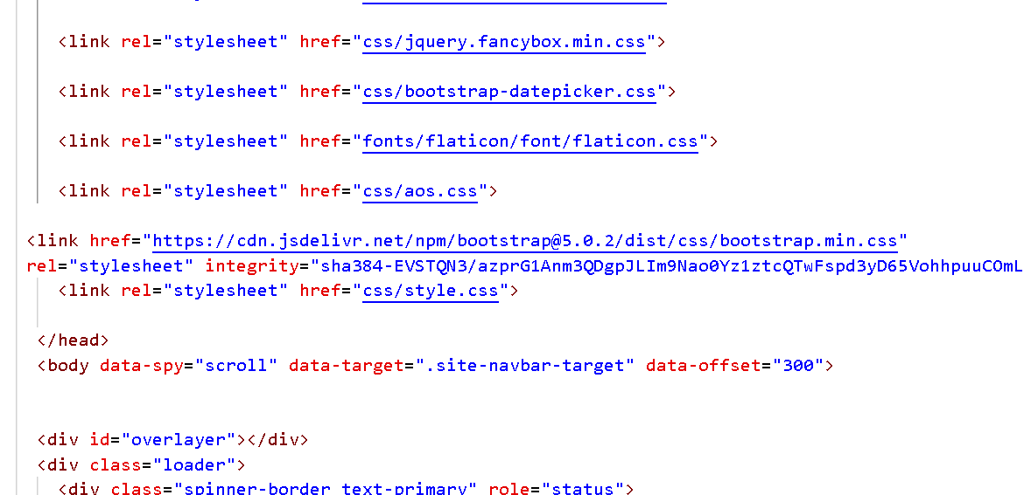
Adding bootstrap features for the web page

Slide 4
Few important bootstrap classes
Container
Container-flud
Btn btn-success
Btn btn-failure
Form-group
Form-control-name
etc

Slide 5
End of the bootstrap we expect
Apply bootstrap classes for all web pages.
Make sure web page must be responsive.
Try to use other third party library if required to make good look and feel like jQuery.

